Slide 1

BUSINESS COMMUNICATIONS 500
TOPIC: TWO
The Writing Process in the Digital Era
Welcome TO Richfield
HYBRID learning

Slide 2
Learning Objectives
In this chapter, you will learn about:
Understand the nature of communication and its barriers in the digital era.
Analyze the purpose of a message, anticipate its audience, and select the best communication channel.
Generate and organize ideas resulting from techniques such as brainstorming and brainwriting along with social media techniques such as crowdsourcing, crowdstorming, and crowdfunding.
Improve your writing techniques by emphasizing important ideas, employing the active and passive voice effectively, using parallelism, and preventing dangling and misplaced modifiers.
Recognize proofreading problem areas, and apply effective techniques to catch mistakes in both routine and complex documents.

Slide 3
Introduction
No one would argue that the digital revolution has not profoundly changed the way we live, the methods we use to conduct business, and especially the way we communicate. For instance, staff members and college interns use videos, Facebook, Twitter, blogs, and e-mail to communicate with each other and create buzz with customers and fans.

Slide 4
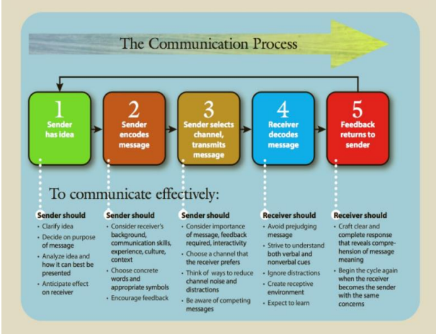
Understanding the communication process

Slide 5
Barriers That Create Misunderstanding
The communication process is successful only when the receiver understands the message as intended by the sender.
You can improve your chances of communicating successfully by learning to recognize barriers that are known to disrupt the process. Some of the most significant barriers for individuals are bypassing, differing frames of reference, lack of language skill, and distractions.

Slide 6
Analyzing and anticipating the audience
For starting any writing process
analyzing the purpose for writing i.e why are you sending the message, what you want to convey to the audience and anticipating the audience i.e how will they react after reading your message and how will they adapt your message.

Slide 7
Using expert writing techniques to adapt to your audience
Adapting your message to the receiver’s needs means being empathic; Empathic senders think about how a receiver will decode a message.
They try to give something to the receiver, solve the receiver’s problems, save the receiver’s money, or just understand the feelings and position of that person.

Slide 8
Beginning with research & Generating Ideas and Organizing Information
Brainstorming
Brainwriting
Many Six Sigma methods have brainstorming, or idea generation, as a starting point. The basic purpose of brainstorming is to come up with a list of options for a task or a solution—usually a longer list that is shortened into a final choice. For example, a team may brainstorm which customers to interview or what questions to ask. Later, the team may use brainstorming again to list possible measures and still later to come up with creative improvement solutions.
Brainwriting is an alternative method to brainstorming. It is a technique for rapid idea generation that eliminates many of the pitfalls of traditional brainstorming meetings.

Slide 9
Generating Ideas and Organizing Information
Crowdsourcing
Crowd-storming
Crowdfunding.

Slide 10
Crowd sourcing
Crowdsourcing involves obtaining work, information, or opinions from a large group of people who submit their data via the Internet, social media, and smartphone apps.
Crowdsourcing is the collection of information, opinions, or work from a group of people, usually sourced via the Internet.
Crowdsourcing work allows companies to save time and money while tapping into people with different skills or thoughts from all over the world.

Slide 11
Crowd funding
Crowdfunding is a way to raise money for an individual or organization by collecting donations through family, friends, friends of friends, strangers, businesses, and more.
By using social media, people can reach more potential donors than traditional forms of fundraising.
Crowdfunding harnesses the power of social networks and the internet to give people the means to raise funds, help others overcome hardship, and meet aspirational goals.
The core principle behind the crowdfunding definition is that you can help a friend or help an entire community.

Slide 12
Crowd storming
Crowd storming is a collaborative brainstorming process that harnesses the collective intelligence and creativity of a large group of people to generate innovative ideas and solutions.

Slide 13
Sounding conversational but professional
Just how informal you can be ,depends greatly on the workplace.
It might seem obvious, but effective communication is vital for almost all jobs and careers. While you might think it’s less necessary for more technical or hands-on roles, it can be the difference between success and struggle.

Slide 14
Sounding conversational but professional
Mastering professional language allows you to articulate ideas clearly, enhances your credibility, and enables you to build strong relationships with clients and colleagues.
It can also provide you with a competitive edge and unlocks new opportunities.

Slide 15
Sounding conversational but professional
Please find attached” – Use when attaching documents or materials to a letter or email.
“I’m writing to inquire about” – Use to express a formal request for information or clarification.
“Thank you for your prompt response” – An expression of gratitude for a quick reply.
“As per our conversation” – To refer to a previous discussion or phone call.
“Please let me know at your earliest convenience” – To Politely request a prompt response.
QUESTION :Discuss formal research method that can be used for research in an organization.

Slide 16
ORGANISING IDEAS INTO STRATEGIES
Organizing information makes it easier to retrieve it efficiently and effectively.
There are two organizational strategies that provide plans of action for typical business messages:
Direct Strategy for Receptive Audiences. In preparing to write any message, you need to anticipate the audience’s reaction to your ideas and frame your message accordingly.
When you expect the reader to be pleased, mildly interested, or neutral use the direct strategy. That is, put your main point the purpose of your message in the first or second sentence.
Explanations and details follow the direct opening. What’s important is getting to the main idea quickly.

Slide 17
Indirect strategy.
When you expect the audience to be uninterested, unwilling, displeased, or perhaps even hostile, the indirect strategy is more appropriate.
In this strategy you reveal the main idea only after you have offered an explanation and evidence.
This approach works well with three kinds of messages:
bad news
ideas that require persuasion
sensitive news
especially when being transmitted to superiors.

Slide 18
Developing business writing techniques
When you are talking with someone, you can emphasize your main ideas by saying them loudly or by repeating them slowly.
You could even pound the table if you want to show real emphasis!
Another way you could signal the relative importance of an idea is by raising your eyebrows, shaking your head, or whispering.
Emphasis in writing is important not only to create variety and maintain interest but also to help readers easily glean the main points from the text.

Slide 19
Developing business writing techniques
Achieving Emphasis Through Style. Although mechanical devices are occasionally appropriate, more often a writer achieves emphasis stylistically.
That is, the writer chooses words carefully and constructs sentences skillfully to emphasize main ideas and de-emphasize minor or negative ideas.
Use the following vivid words for emphasis.
Walk — stride, skip, amble, meander, wander, sidle, hike, saunter, stroll
Eat — gobble, munch, chew, nibble, devour, bite, taste, ingest, swallow
Get — earn, win, obtain, acquire, score, grab, secure, attain, fetch, capture
Make — craft, construct, manufacture, prepare, produce, assemble, fashion, create
Tell — advise, explain, disclose, declare, instruct, inform, notify

Slide 20
3-x-3 writing process
The 3×3 writing process is a simple method where writing is divided into three distinct stages: prewriting, writing, and revising.
Its purpose is to develop your writing skills while training you to be organized with your details and presentation.

Slide 21
3-x-3 writing process
Prewriting is the first stage of the 3×3 writing process.
This is your brainstorming stage: you think about a topic, its content, your audience, and their likely reaction.
Writing is the second stage of the 3×3 writing process.
This is where you actually begin putting your ideas into words.
You’ve already made an outline during your prewriting stage; now it’s time to flesh those ideas out.
Revising is the final stage of the 3×3 writing process. At this stage you already have a version of your work, but you’ll still need to polish it up.
This is where your zero draft becomes your final draft—what you present to your readers. It is further divided into three tasks: revise, proofread, and evaluate.

Slide 22
Evaluating the effectiveness of your message
Have you ever been misunderstood or surprised by a reaction to your message? We are often poor judges of our own communications.
We may be certain of a message, its meaning, and intent, and may assume that the message will be clear to the receiver.
Evaluate what you have written to be certain that it attracts the reader’s attention.
Is it polished and clear enough to convince the reader that you are worth listening to?
How successful will this message be? Does it say what you want it to? Will it achieve your purpose? How will you know whether it succeeds?
The best way to judge the success of your communication is through feedback.

Slide 23
Research questions:
How are speakers different from writers in the way they emphasize ideas?
The use of digital communication has overtaken face-to- face and voice-to voice communication in the workplace. Has this shift changed the fundamental process of communication?

Slide 24
THANK YOU
PG 53

